Slide 1
Credit Card Default Prediction
-Henry Jacob

Slide 2
Problem Statement
Financial threats are displaying a trend about the credit risk of commercial banks
as the incredible improvement in the financial industry has arisen. In this way,
one of the biggest threats faced by commercial banks is the risk prediction of
credit clients. The goal is to predict the probability of credit default based on
credit card owner's characteristics and payment history.

Slide 3
Technology Used
Language - Python
Packages - numpy, pandas, matplotlib, seaborn, sklearn, imblearn

Slide 4
Approaches Problem
Problem stated
defined business objective
Data Collected
Data Wrangled
Performed EDA
Tried all model and chose best one
Model trained and tested

Slide 5
EDA Insights
Class 1 has more months delay payment than Class 0 from June to September
Class 0 has more amount of bills than Class 1 in September
Ages in the range between 20 – 80
More customers are married than unmarried
More Customers from University followed by Graduate School and High School

Slide 6
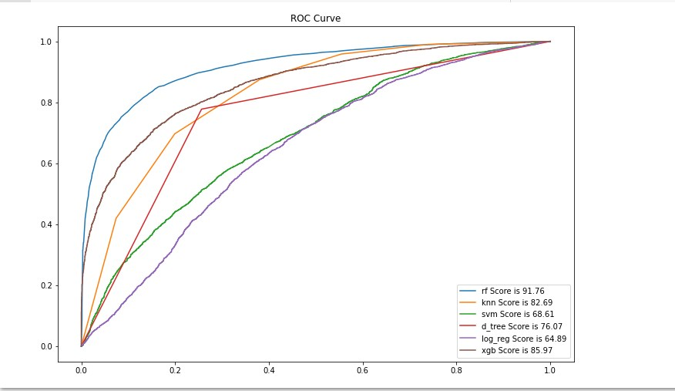
Best ML Model

Slide 7
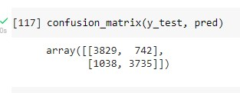
Evaluation Metrics of Model

Slide 8
Thank you!

